Slide 1
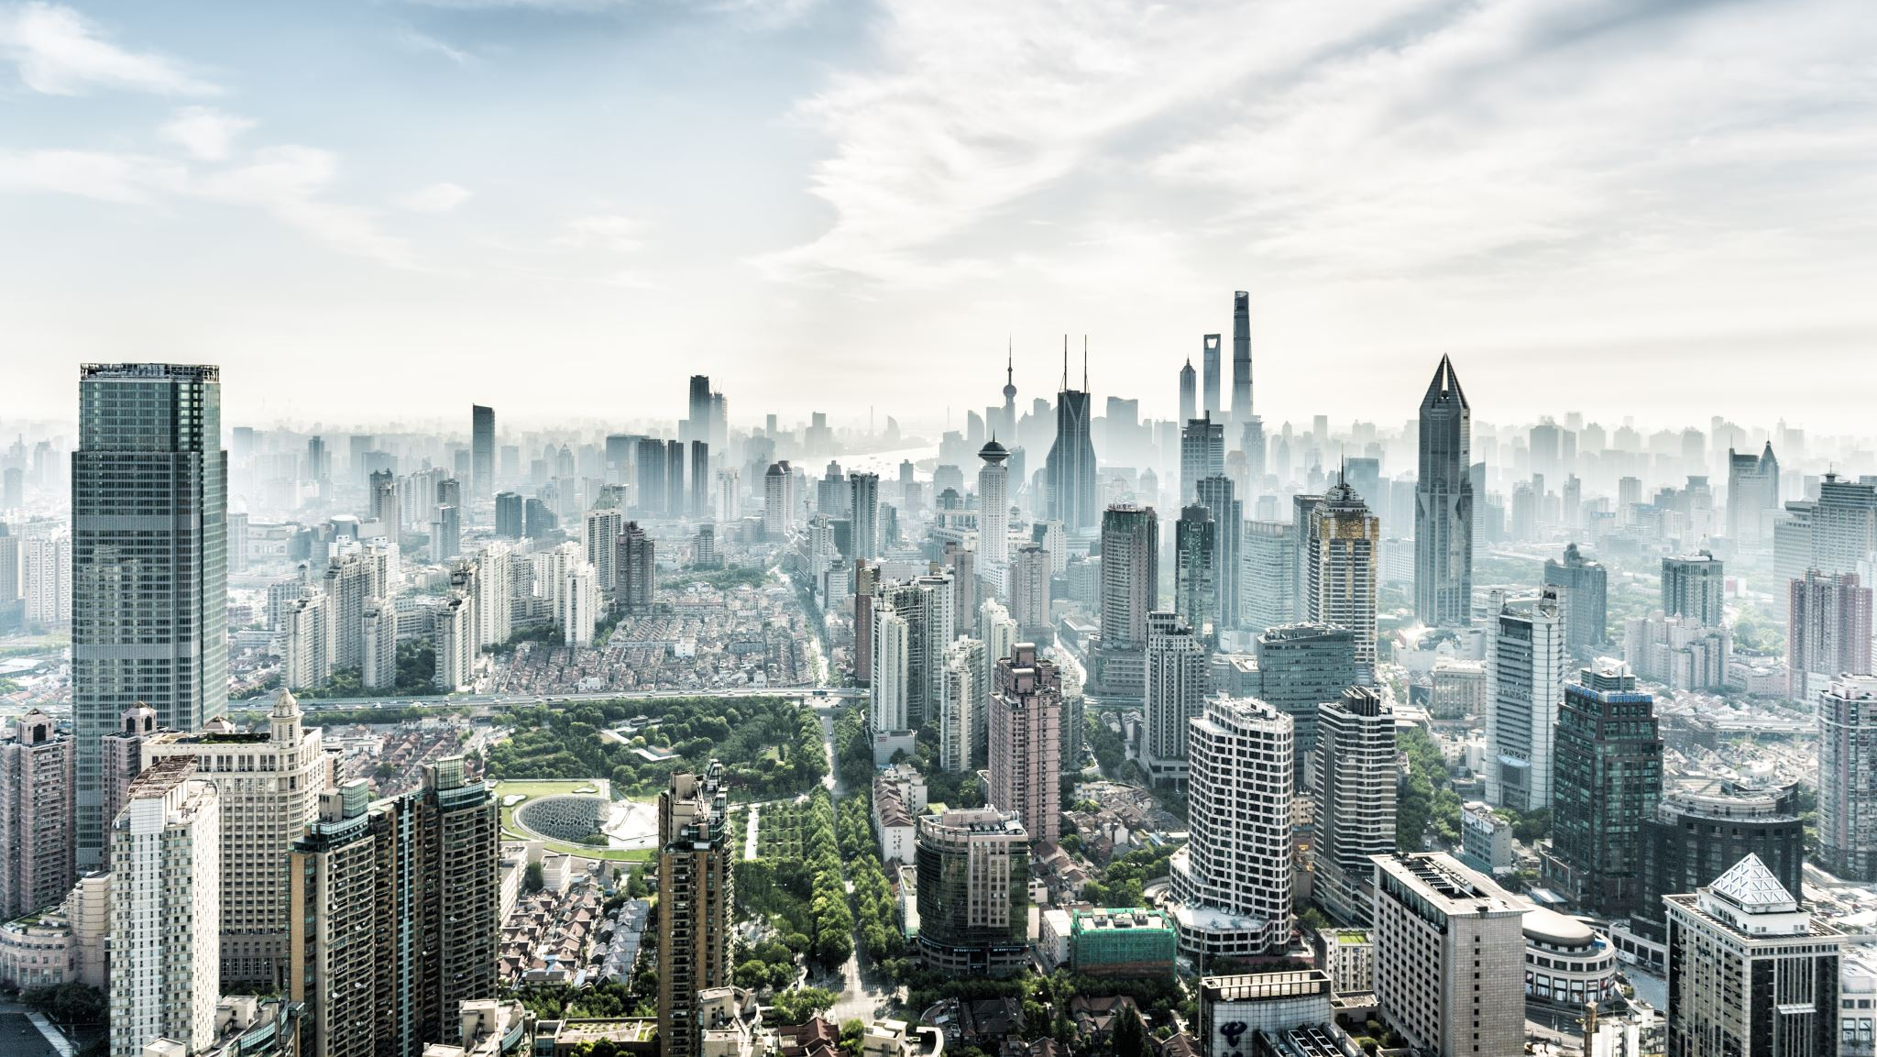
Privacy Concerns with Embracing Smart Cities
Evaluating the impact of Chief Privacy Officer appointment on public privacy sentiment
TEAM 19
Pranjal Sharma
Mandhani Kushal

Slide 2


Motivation
Smart cities have slower adoption rate due to high privacy risks for the citizens.
No efficient solutions exist to tackle this issue.
Notes:
Smart cities require collection of large amounts of data from various devices.
This data is then processed, and services are adjusted accordingly.
Privacy concerns are high due to this leading to slower adoption of smart cities than expected.

Slide 3
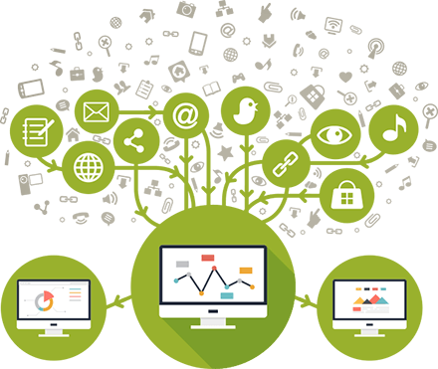
Background – Smart city
Collection of enormous amounts of data
Process and manipulate city operations to provide better services
This leads to high privacy concerns
Notes:
Smart cities require collection of large amounts of data from various devices.
This data is then processed, and services are adjusted accordingly.
Privacy concerns are high due to this leading to slower adoption of smart cities than expected.

Slide 4

Background - Chief privacy officer
A dedicated officer for privacy to help avoid attacks on people’s privacy
Office is responsible for designing and implementing practices to protect user data
Enforce Laws and Policies
Anonymize Data
Notify about Data Collection
Publish Technical Details
Some Responsibilities:

Slide 5
Problem Statement
Chief Privacy Officer (CPO) has been a significant success in the industry
Evaluate CPO’s impact on public privacy sentiment for smart cities

Slide 6
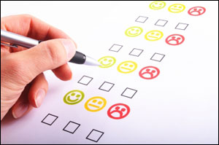
Approach
User Study!
Survey Design
Survey Distribution
Data Analysis

Slide 7
Survey Design
Design Aim:
Provide more context to users
Make survey engaging for users
Three scenarios for this purpose:
Predictive Policing
Prevent crimes by predicting them based on surveillance and historical crime data.
Smart Complaint System
Complaint kiosks in public places to conveniently raise complaints with government departments.
Smart Transportation
Using cameras to assess demand for buses and adapt accordingly.

Slide 8
Survey Design – Continued…
Survey
Without CPO
Predictive Policing
Smart Complaint System
Smart Transportation
With CPO
Predictive Policing
Smart Complaint System
Smart Transportation
High? Rate responsibilities of CPO
Low? Suggest practices

Slide 9
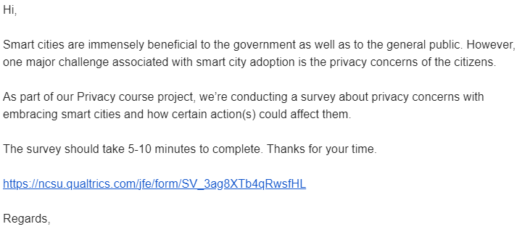



Survey distribution

Slide 10
Evaluation
Pie charts and CCDF plots to show change in user’s comfort level sharing their data.
CCDF plots highlight the distribution of the responses received.
Stacked bar charts to identify impact of different responsibilities of CPO (for users with high confidence in CPO).
Identify useful suggestions (for users with low confidence in CPO).

Slide 11
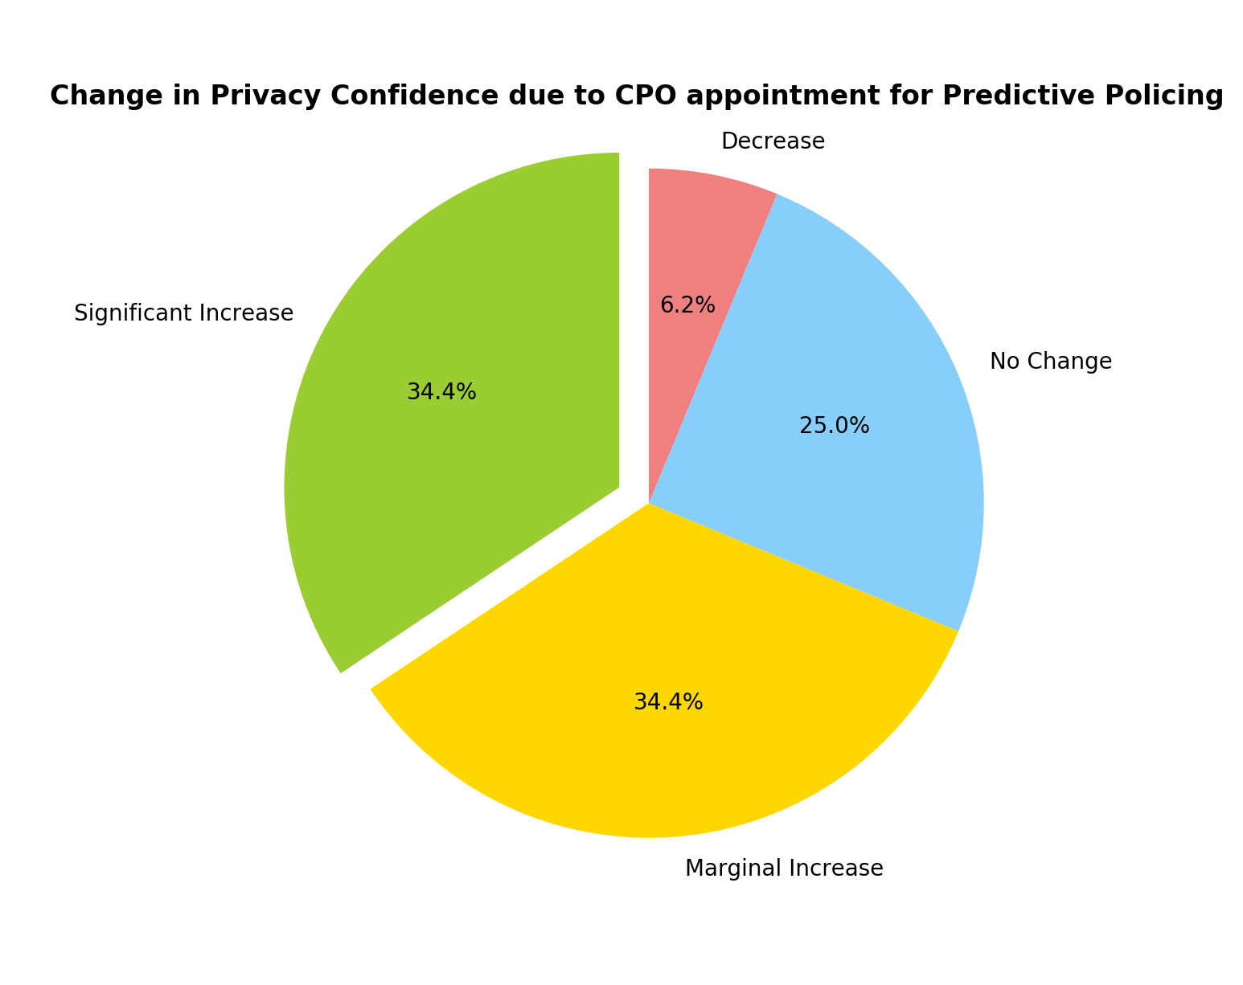
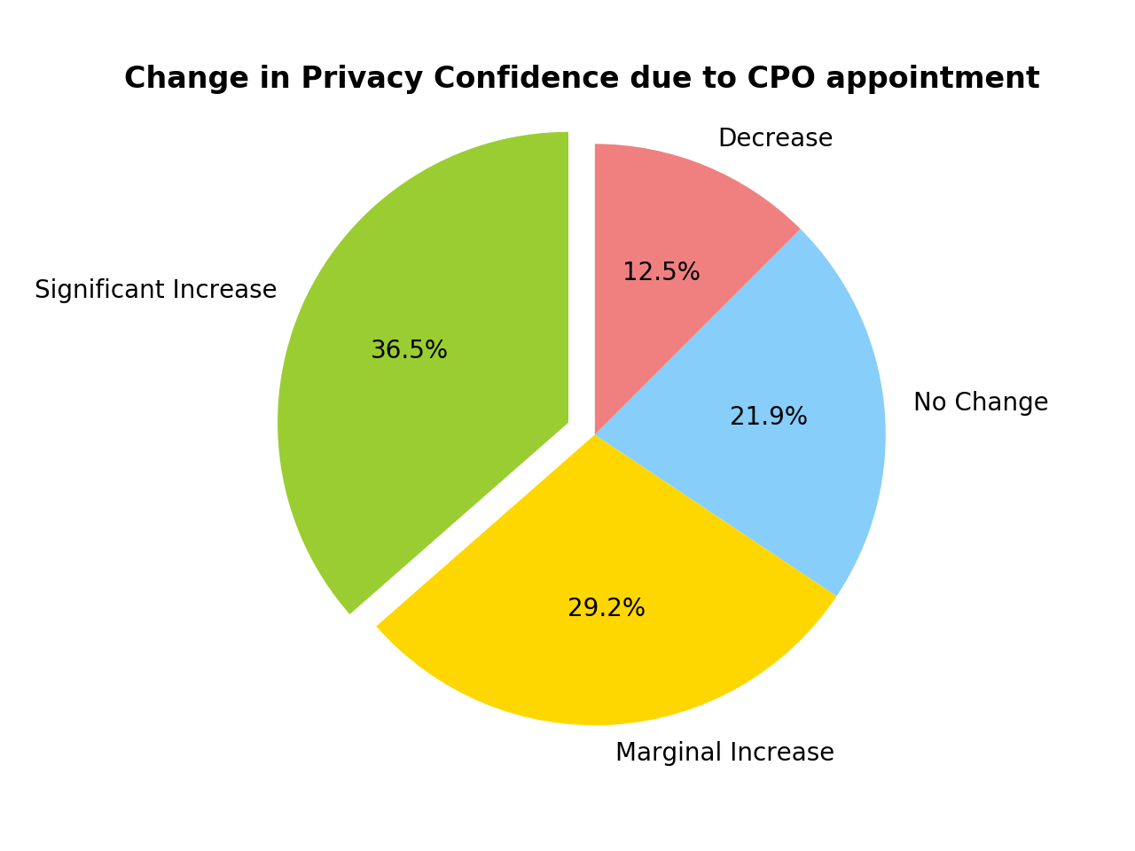
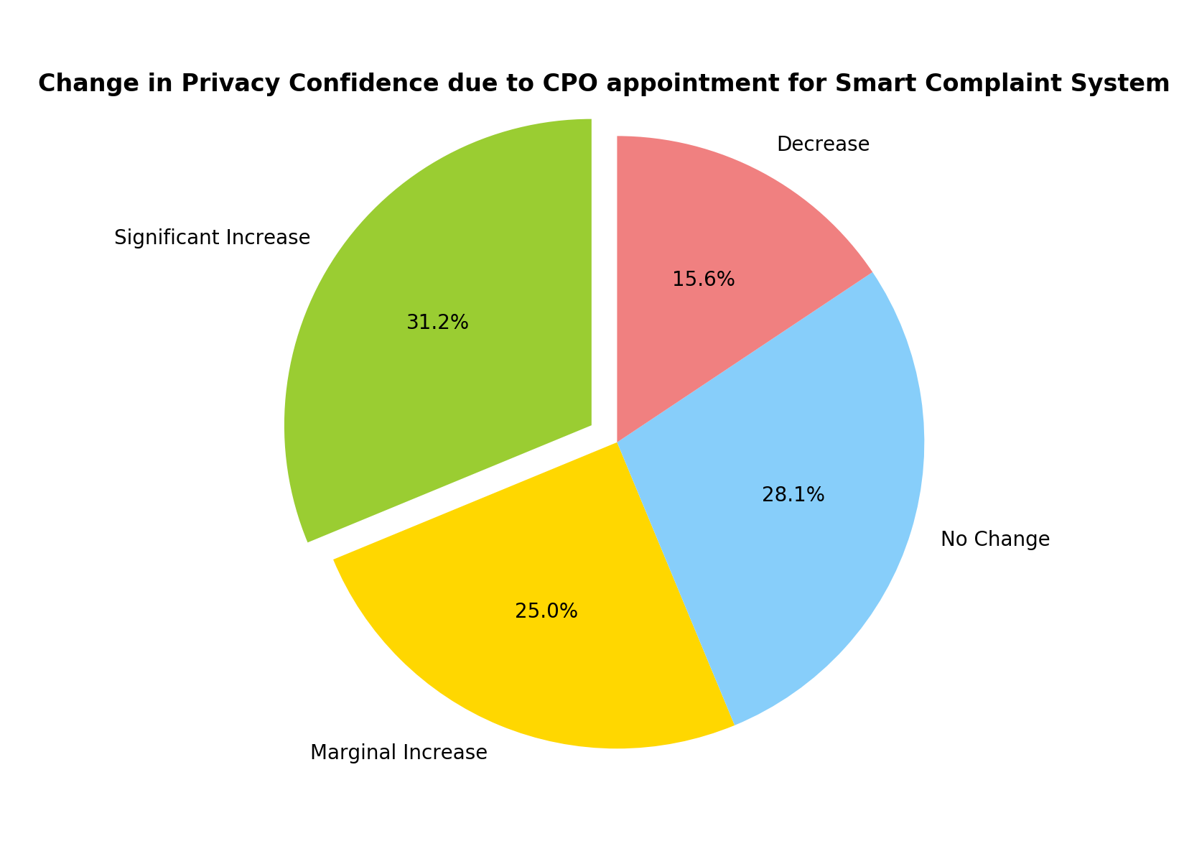
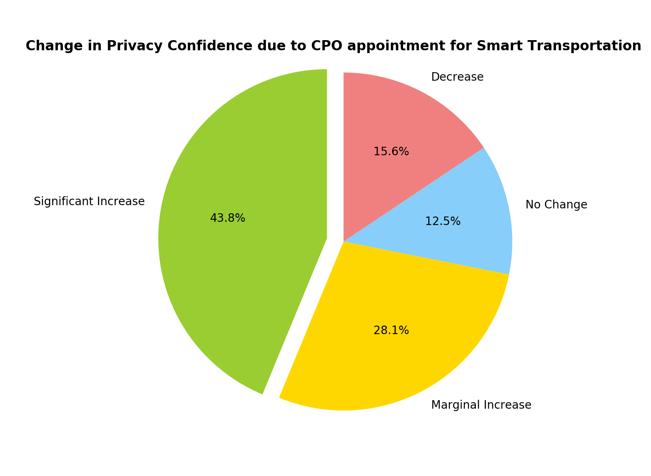
Results
Overall increase in 65.7% of the users.
Significant increase in 36.5%

Slide 12
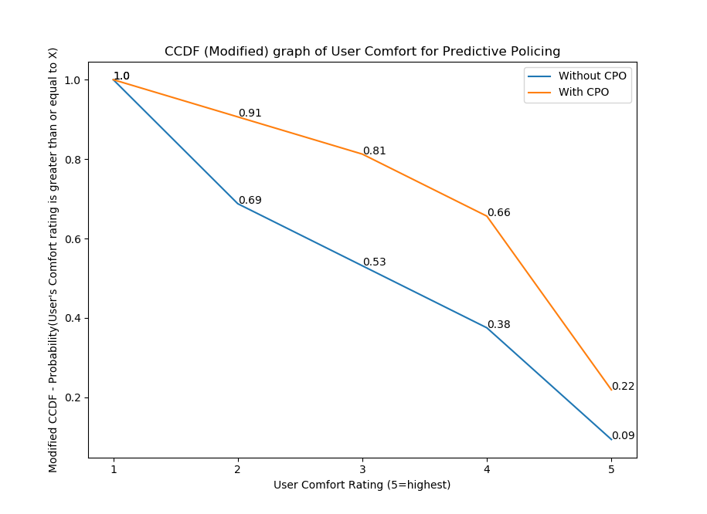
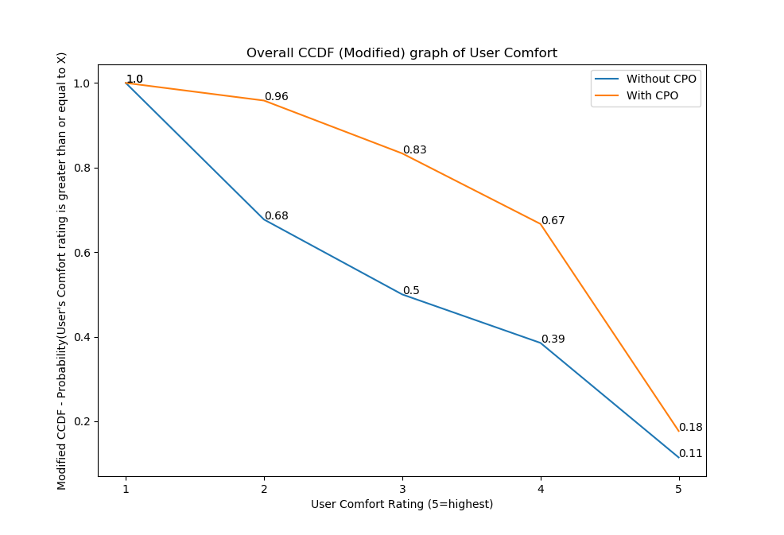
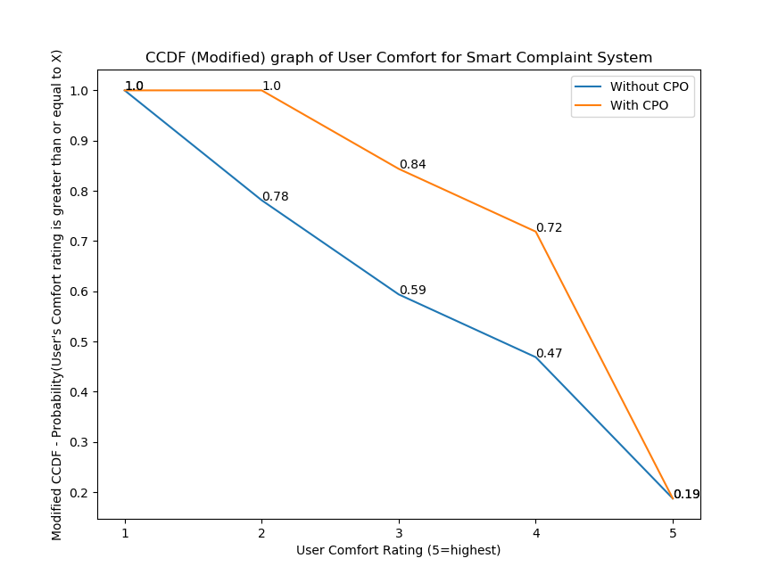
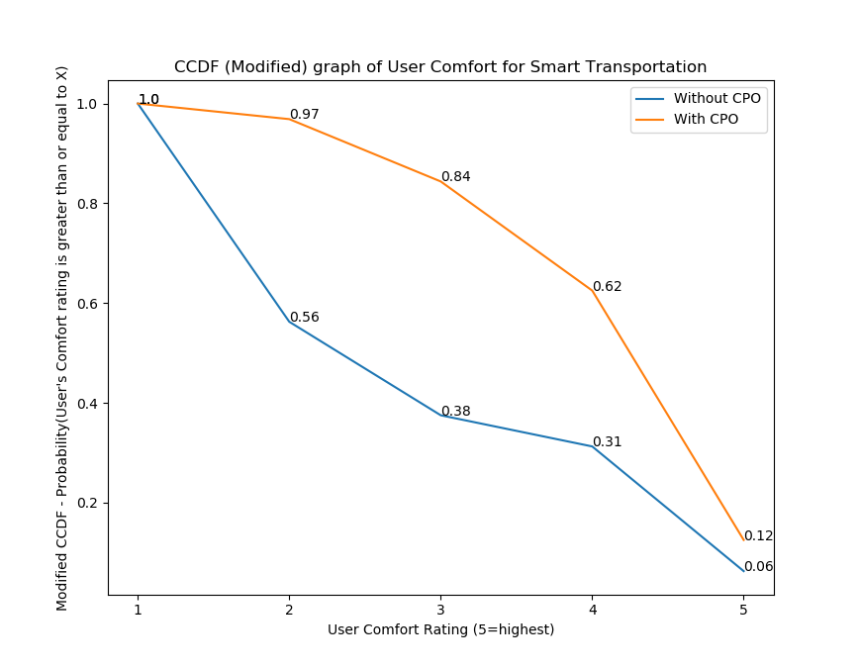
Results – Continued…
Most improvement!
User comfort ratings are higher in presence of CPO.
Throughout the distribution.

Slide 13
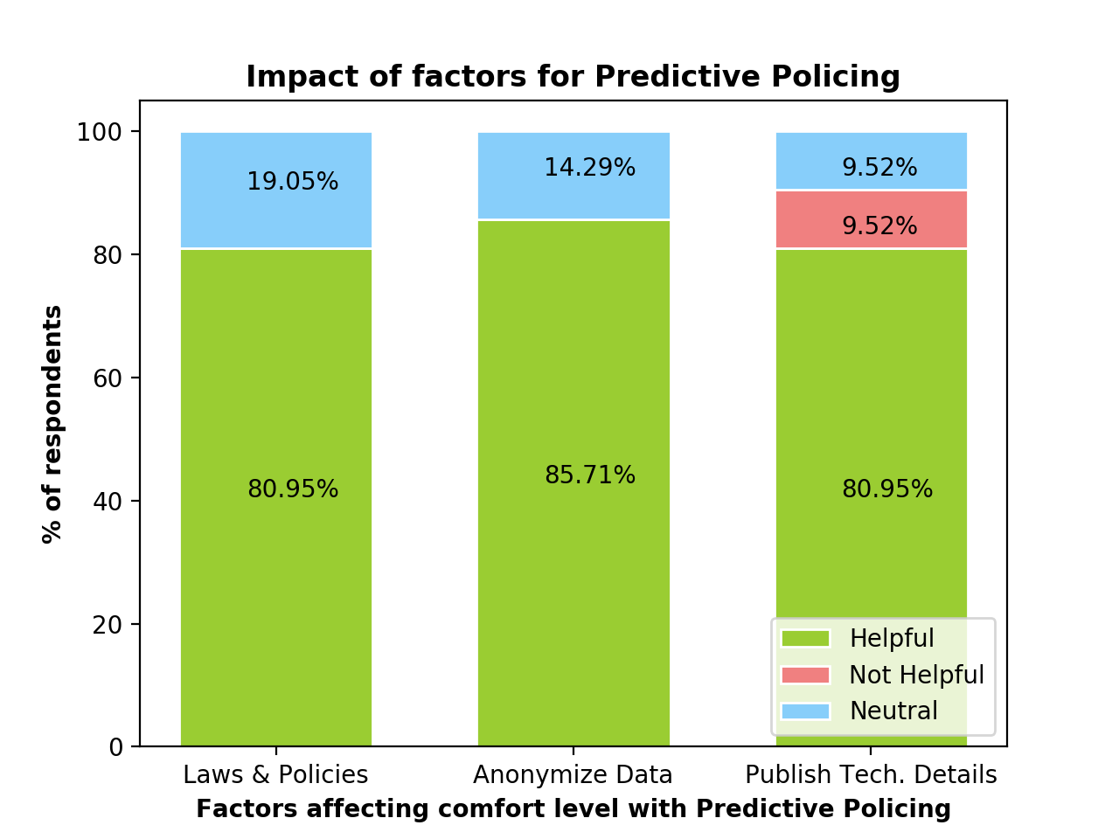
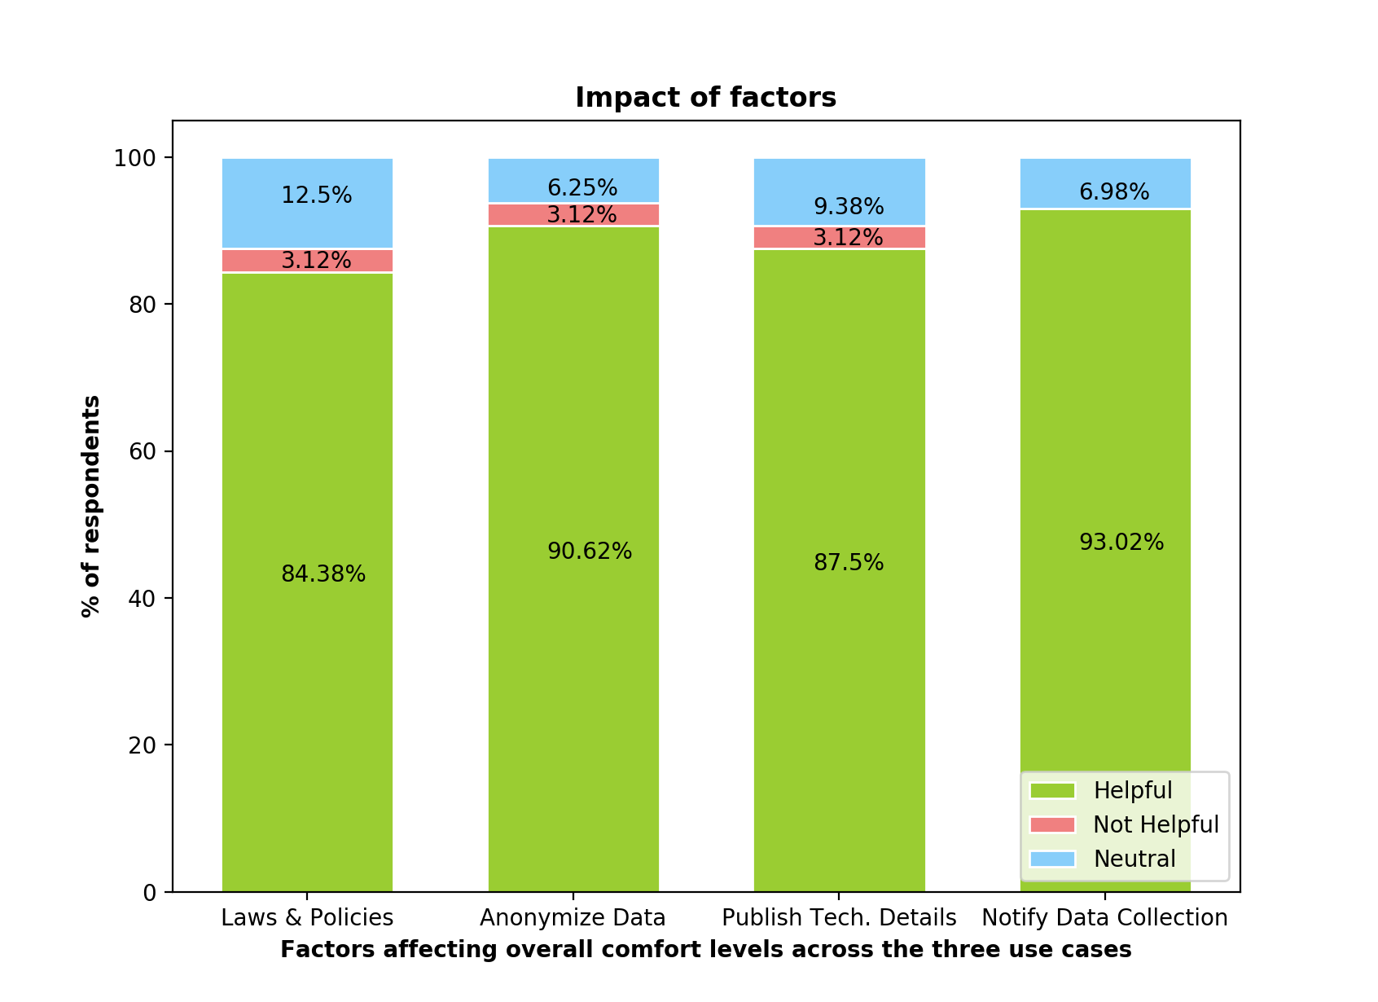
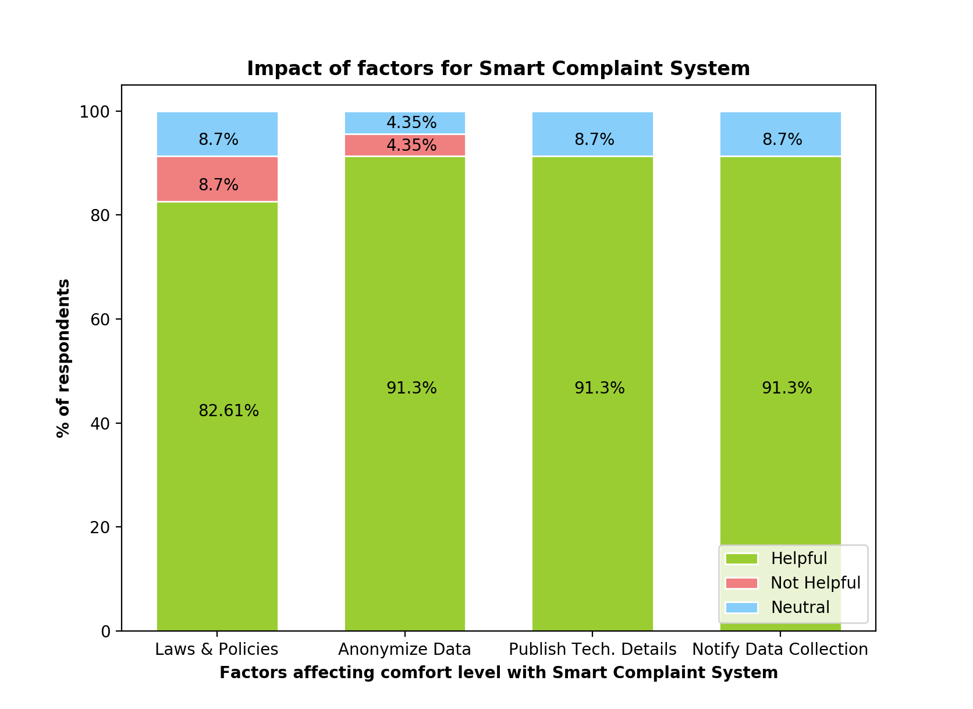
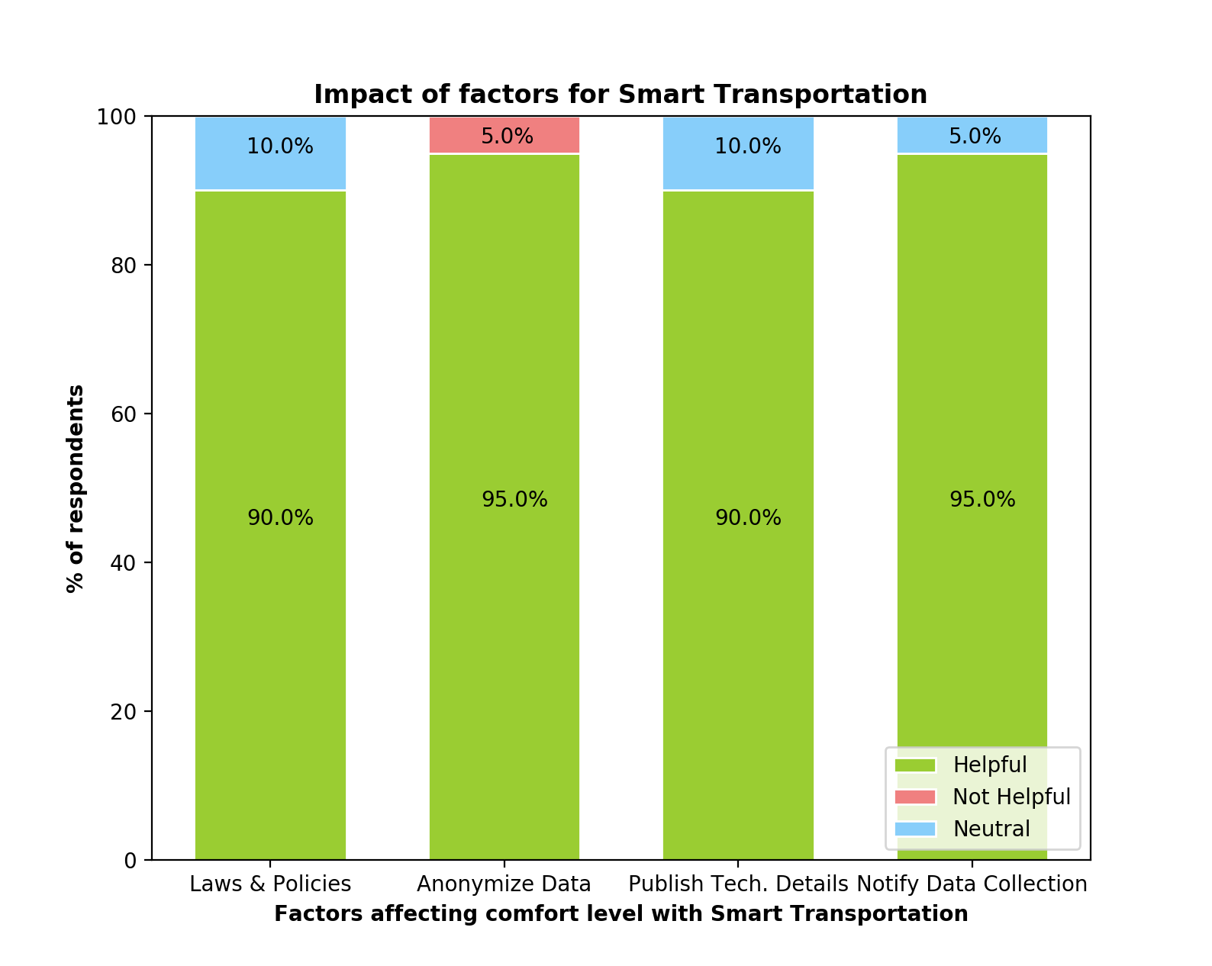
Results – continued…
All factors are found helpful by at least 84% of users
Most Helpful: Notify about Data Collection.
Least Helpful: Enforce Laws and Policies.

Slide 14
Results – continued…
Notable suggestions made by users with low comfort level in the presence of CPO
Predictive Policing:
Predictive Policing should only use criminal records and valid security breaches and not do complete surveillance.
The smart city police should undergo training to have no biases.
Smart Complaint System:
The smart city should have stricter rules and fines on violation of privacy laws and policies.
Third-party auditing (on a yearly basis) to review privacy practices.
Smart Transportation:
Use of other simpler methods instead of cameras.
On-demand available information.

Slide 15
Summary of findings
Overall, appointment of CPO significantly increases the privacy confidence in 36.5% of the users.
Including marginal increase, 65.7% of the users’ privacy confidence increased.
Smart Transportation saw the most increase in user confidence after appointment of CPO.
All the factors contribute significantly to the high comfort level of users to share data.
"Notify about Data Collection" and "Anonymize Data" lead with a small margin.

Slide 16
Limitations and future work
Limitations:
Sample Size
For a more thorough analysis, more responses would’ve been needed.
Respondent Diversity
Current respondents were mostly students (some were working professionals).
More diversity in terms of age and exposure to smart cities would’ve been ideal.
Future work:
More factors:
More factors can be added thereby making it more fine-grained and comprehensive.
Clustering responses
Clustering techniques can be used to automatically group user responses mentioning techniques that would increase their confidence levels

Slide 17

Thank you!

